Slide 1
Buying products from whom you know: personal connections and information asymmetry in supply chain relationships
Ting Chen
Hagit Levy
Xiumin Martin
Ron Shalev
Review of Accounting Studies
April 2021
Presented by: Yan Li

Slide 2
Research Question:
What does the role personal connections play in a crucial element of the supply chain—supplier selection?

Slide 3
Literature Contributions
The findings highlight the importance of personal connections in a critical firm operating decision. The results show personal connections increase a vendor’s chance of being selected as a supplier.
The findings highlight the role of personal connections in transmitting soft information and expanding geographical constraints along supply chains, complementing research documenting their importance to mutual fund managers’ investment decisions (Cohen et al. 2008) and firms’ external financing decisions (Engelberg et al. 2012)
This paper shows personal connections relax procurement-contract terms and improve firms’ operating efficiency.

Slide 4
Hypothesis Development
The likelihood that a vendor becomes a supplier increases if personal connections exist between the vendor’s and the customer’s executives.

Slide 5
Sample Selection
Compustat Industry Segment file: identify first-time customer-supplier relations among U.S. public firms with available data from year 2000 through 2011.
BoardEx database: reports work histories, educations, and participation in social organizations for C-level (e.g., CEO and CFO) executives, lower-level executives, and current directors
Compustat: financial data
CRSP: stock return data

Slide 6
Identification of Non-supplier vendors
A total of 2630 non-supplier vendors for 1430 suppliers:
- A firm must have data available on BoardEx.
- Use the Mahalanobis distance approach to identify up to two non-supplier vendors from the same four-digit SIC industry and the same fiscal year that are closest to the supplier with respect to size (total assets), performance (ROA), and sales.

Slide 7
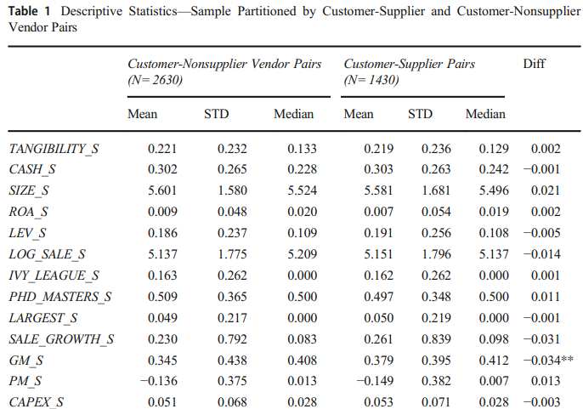
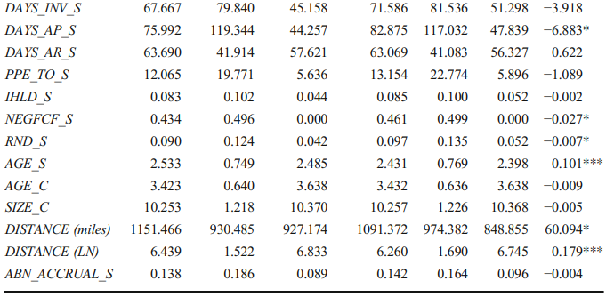
Descriptive Statistics
Except for a few variables (e.g., supplier gross margin and age), non-supplier vendors and suppliers are similar in most fundamental characteristics, suggesting the three variables - size (total assets), performance (ROA), and sales- employed in the Mahalanobis distance approach do a good job matching the non-supplier vendors with suppliers.

Slide 8
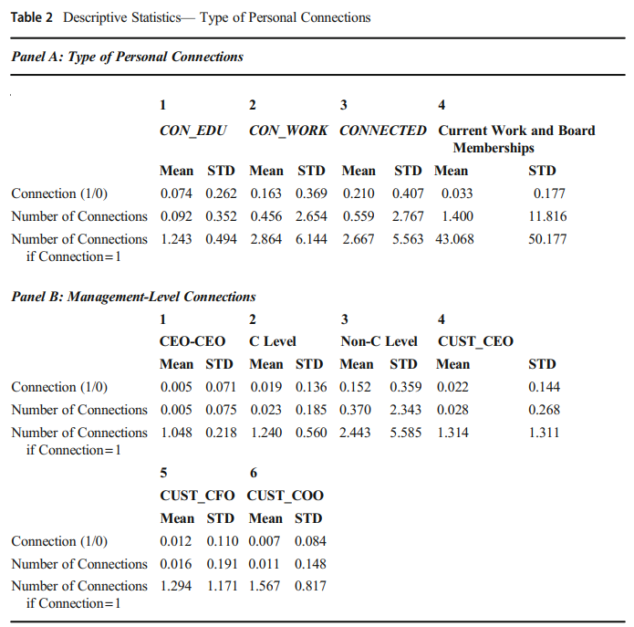
Descriptive Statistics
Panels A and B focus on the source of connections and the role of the connected executives in a firm, respectively.
The statistics suggest the connections on which we focus are common in the product market.
Notes:
Connection=1: Conditioning on the existence of at least one educational connection between a pair of firms.
Panel A shows that 7.4% of our sample have educational connections, 16.3% have past-work connections, and 21% have either educational connections or past-work connections. Connections through current employment or board memberships exist for 3.3% of the sample.
Panel B shows that 0.5% of the sample observations have connections between CEOs, 1.9% have connections between C-level executives at both firms, and 15.2% have connections between non-C level executives at both firms. Customers’ CEOs (CFOs) are connected with vendor executives at all rank levels for 2.2% (1.2%) of the sample, and customers’ COOs are connected in 0.7% of the sample.

Slide 9
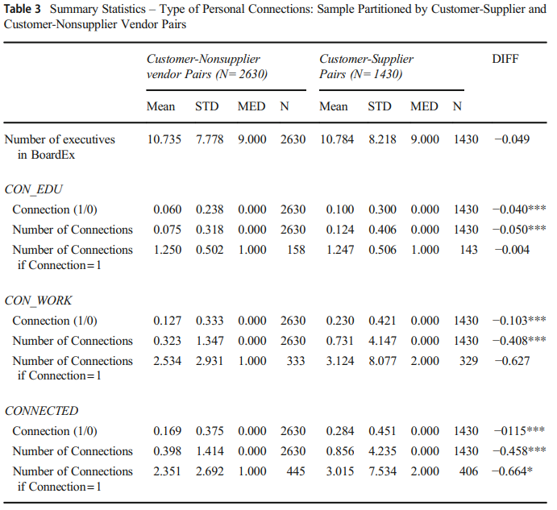
Descriptive Statistics
Takeaway:
Personal connections may affect supplier selection
Notes:
Table 3 reports summary statistics of personal connections for the sample partitioned based on whether the vendor is also a supplier.
The average number of executives per firm reported on BoardEx is comparable between suppliers and non-supplier vendors, but the percentage of suppliers that are personally connected is greater than the percentage of non-supplier vendors (educational connections: 10% versus 6%; past-work connections: 23% versus 12.7%). We find similar results when we consider the number of connections between a pair of firms.

Slide 10
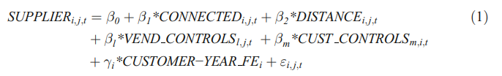
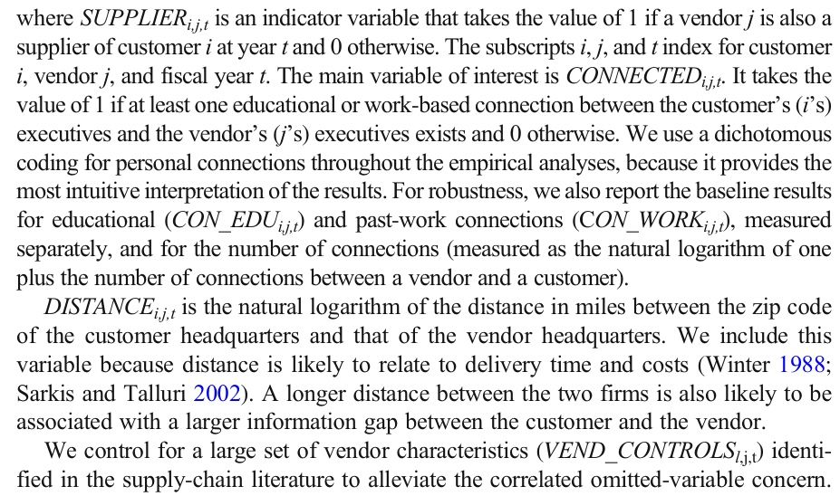
The effect of personal connections on customers’ choice of suppliers

Slide 11
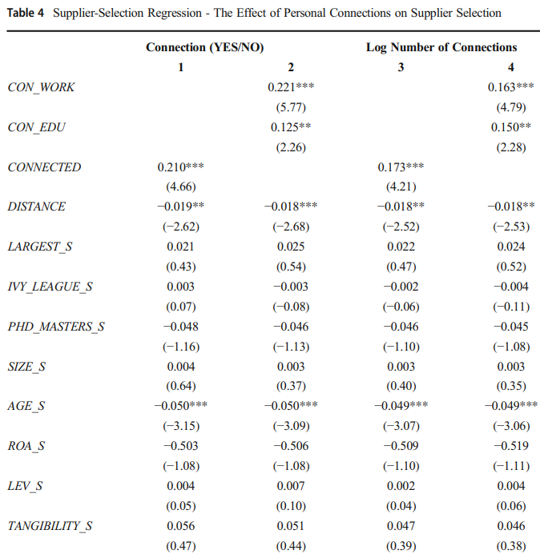
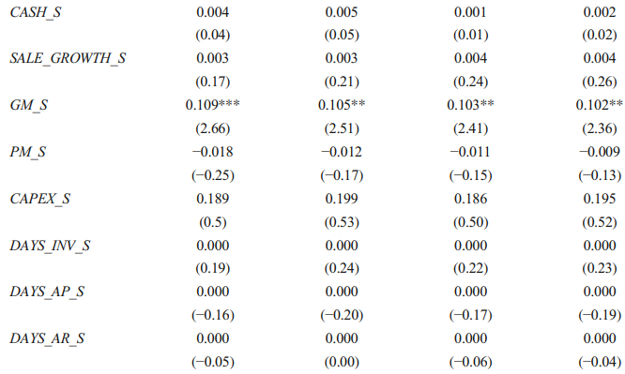
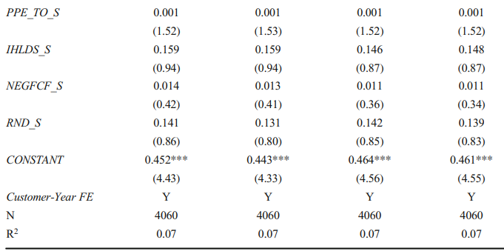
The effect of management rank and position
Notes:
In columns 1 and 2, personal connections are measured as an indicator variable that takes the value of 1 for the existence of personal connections and 0 otherwise. In columns 3 and 4, they are measured as the natural logarithm of one plus the number of connections. In columns 1 and 3, the personal-connections measure captures both work-based connections and educational connections (CONNECTED), and, in columns 2 and 4, each type of personal connec tion is measured individually (CON_WORK and CON_EDU).
The coefficients on connection variables, CONNECTED, CON_EDU,andCON_WORK, are positive and significant at the 5% level or better across all specifications. Results in column 1— coefficient on CONNECTED of 0.217—suggest the existence of a personal connection increases the likelihood of being selected as a supplier by 21%, representing a 60% increase over the baseline probability (35%). Results in column 2 suggest the effect of past-work connections is larger than that of educational connections (0.221 versus 0.125). The coefficient on DISTANCE is significantly negative as predicted.

Slide 12
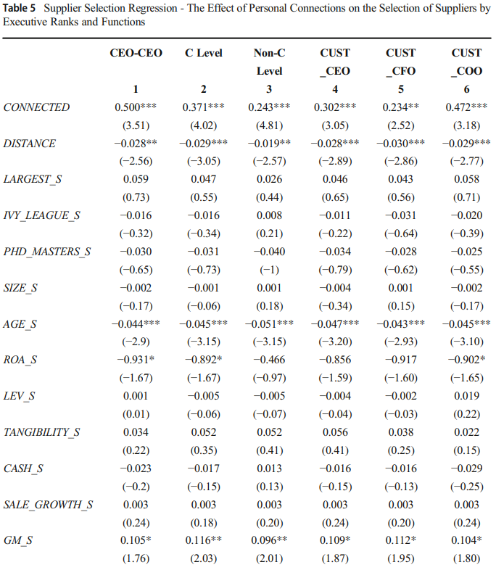
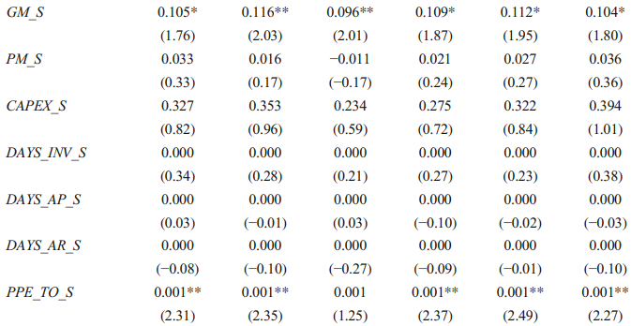
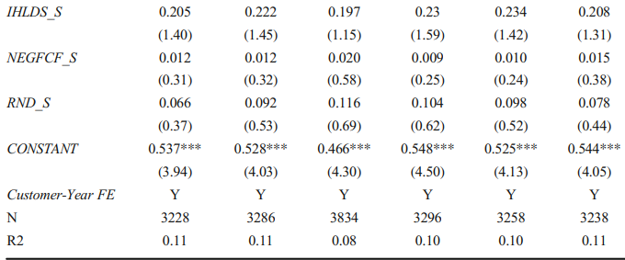
The effect of management rank and position
The effect of personal connections on suppliers election varies with executives rank and position
Notes:
Columns 1–3 focus on executive ranks: CEOs in column 1, C-level executives (e.g., CEO, CFO, and COO) in column 2, and lower-level executives in column 3. The coefficient on CONNECTED is positive and significant for all executive ranks. The magnitude of the coefficient is larger for C-level connections than for non C-level connections (0.371versus0.243), with the largest effect coming from the connections between CEOs (0.500).The difference in the coefficient estimates between the CEO connections and the non-C-level connections is significant at the1% level using an F-test.
Columns 4–6 focus on customer executives’ function. Column4 reports results for vendor connections (at any level and position) with the customer’s CEO; column5, for vendor connections with the customer’s CFO; and column 6, for vendor connections with the customer’s COO. The coefficient on CONNECTED is positive and significant across all executive functions. The magnitude of the coefficient is larger for the COO(0.472) than for the CEO (0.302) or the CFO (0.234), and the differences are statistically significant at the 1% level using an F-test.

Slide 13
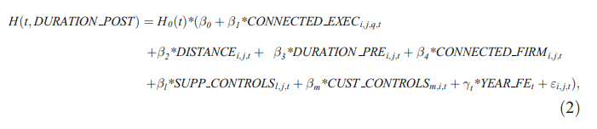
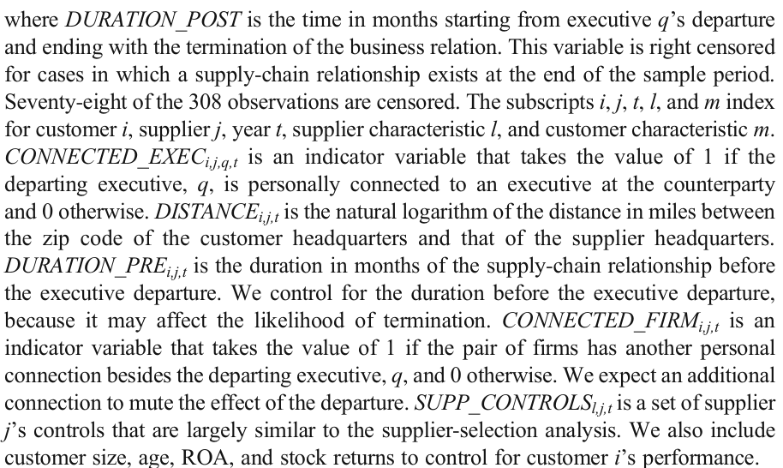
Executive departure analysis

Slide 14
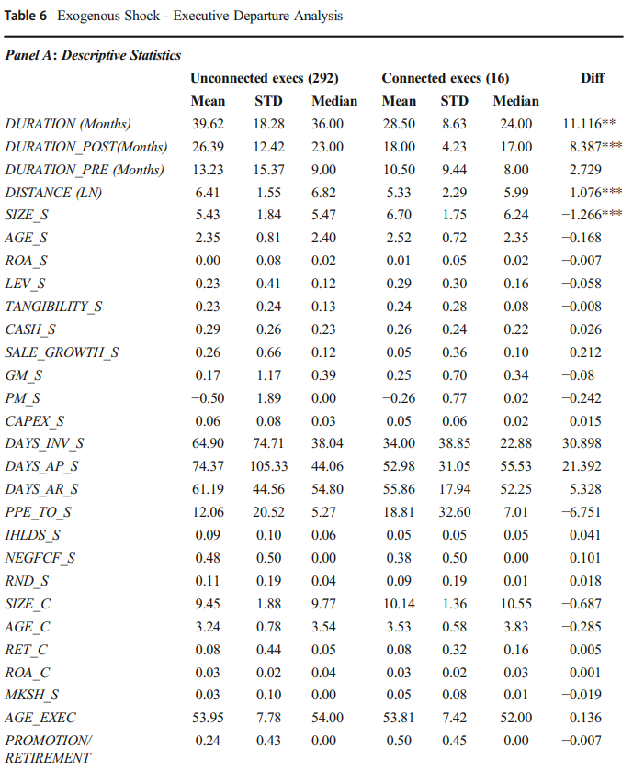
Executive departure analysis
Notes:
Table 6, Panel A, reports descriptive statistics for the 308 observations used in the analysis, partitioned based on whether the departing C-level executive is personally connected. A little over 5% of the departing executives are personally connected. The average duration of the customer-supplier relationship prior to the departure of the executive is similar for both connected and unconnected executive departures (10.5 months versus 13.2 months, respectively). However, the post-departure duration exhibits a significant difference— 18 months for the connected executive departure versus 26.4months for the departure of an unconnected executive. (The difference is significant at the 1% level.)

Slide 15
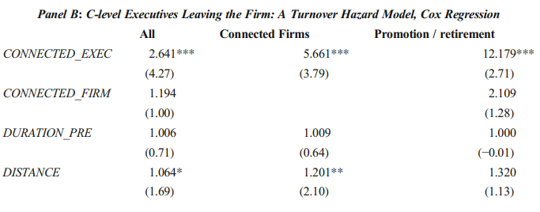
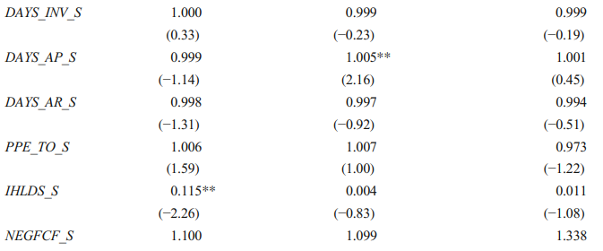
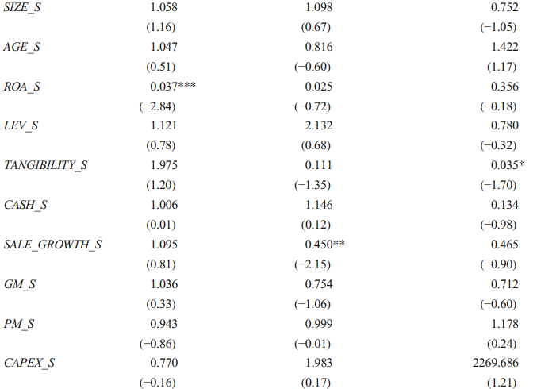
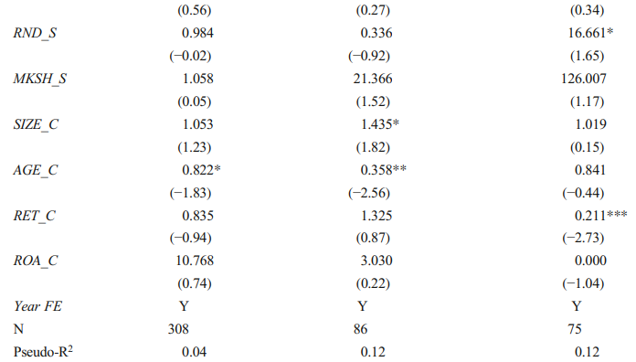
Executive departure analysis
A loss of personal connections between supply-chain partners precipitates the termination of their supply-chain relation.
Notes:
In column1, the departure of a connected C-level executive increases the hazard of terminating the supply-chain relationship 2.64 times, relative to an unconnected executive departure.
In column 2, the departure sample is restricted to only connected customer supplier pairs. Results convey a similar message—that a departure of a connected executive precipitates the end of the business relations more often than a departure of an unconnected executive.
Column 3 considers only departures that are likely due to promotion or retirement to verify that the departures are truly exogenous and unrelated to poor firm performance. Same results are obtained.

Slide 16
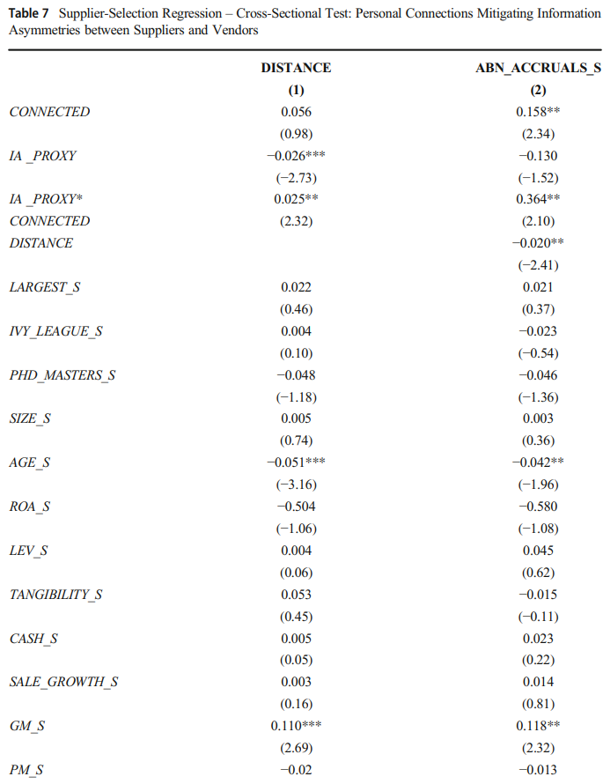
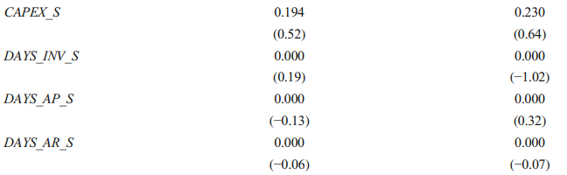
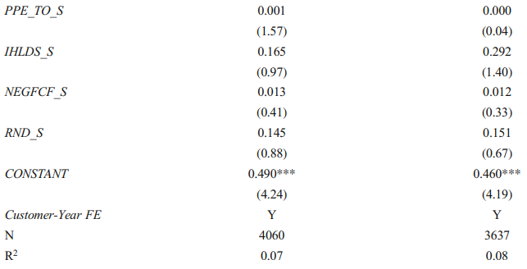

Do personal connections mitigate information asymmetries in supplier selection?
The importance of personal connections to supplier selection increases with information asymmetry.
Notes:
Table 7 reports results that are based on our baseline sample of 4060 observations. The main effect of information asymmetry is negative and significant. The effect of distance is negative but not statistically significant for abnormal accruals. Consistent with our expectation, the interaction between the information-asymmetry proxy and personal connections is positive and significant for both measures.

Slide 17
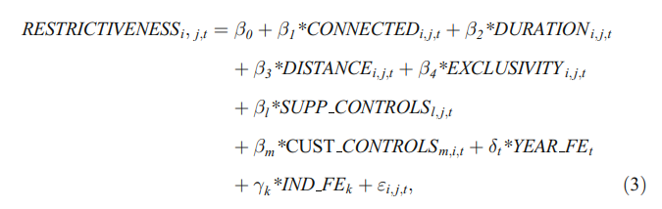
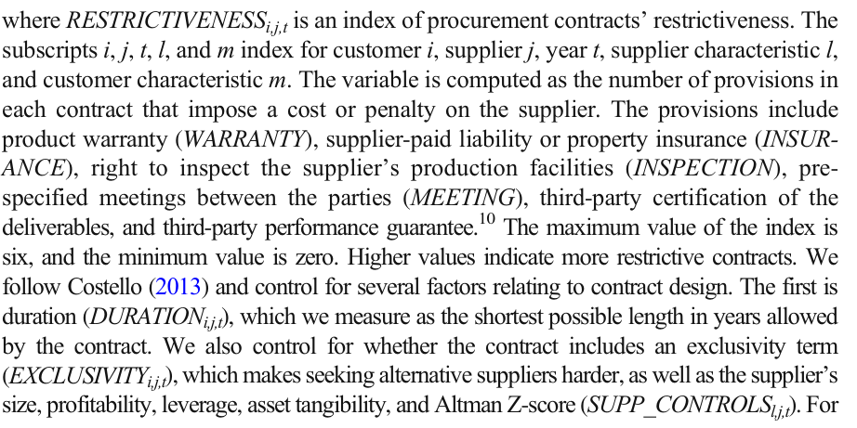
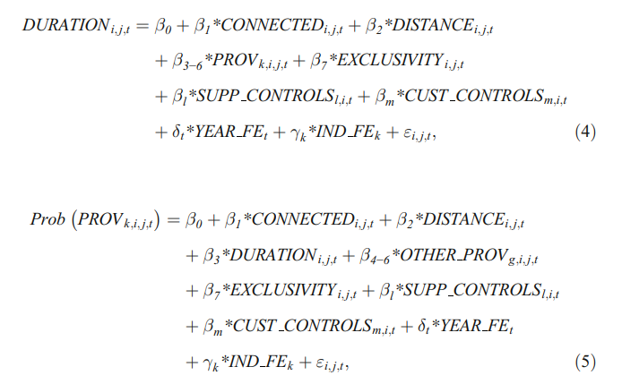
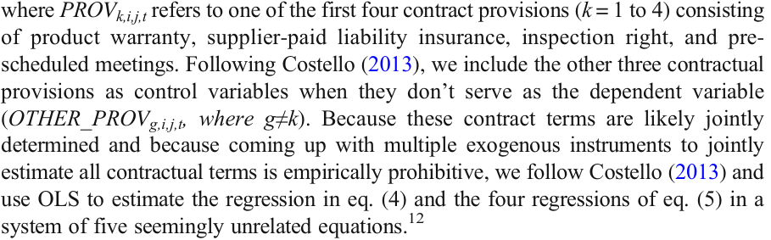
Consequences of personal connections in the supply chain

Slide 18
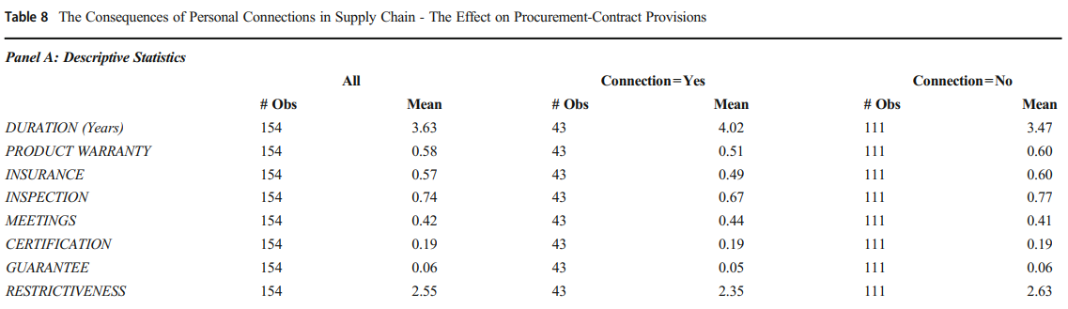
The effect of personal connections on provisions in procurement contracts
Table 8, Panel A, reports descriptive statistics for the sample of 154 procurement contracts. 43 (27%) contracts involve connected supply-chain parties. On average, a procurement contract includes an average of 2.55 provisions restricting the supplier. Contracts with personal connections between a customer’s and supplier’s executives are, on average, less restrictive to the supplier (2.35 versus 2.63 restrictive provisions) than those with no connections.

Slide 19
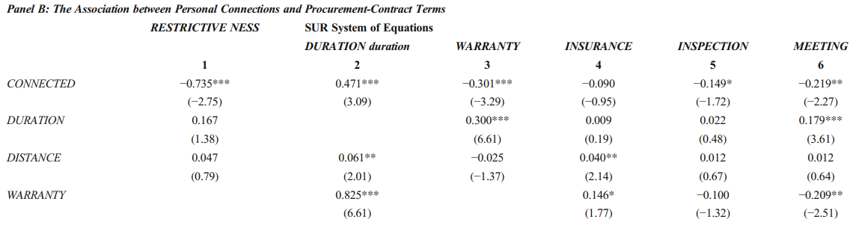
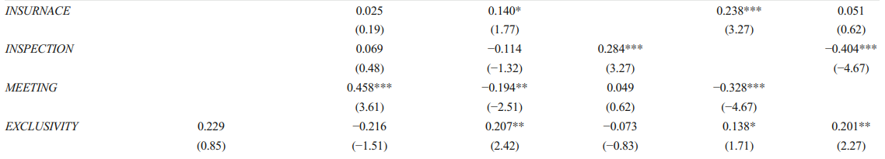
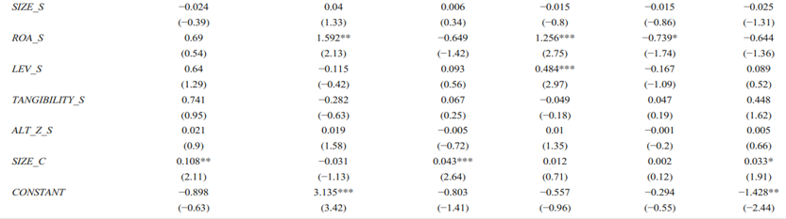
The effect of personal connections on provisions in procurement contracts
Notes:
Panel B, reports regression results. Column 1 reports results where the dependent variable is the restrictiveness index, composed of all six provisions. The coefficient on personal connections is negative and significant at the 1% level, indicating the existence of personal connections reduces the restrictiveness by 0.74.
Columns 2–6 report results for contract duration, requirements of product warranty, supplier-paid liability insurance, the customer’s right to inspect the supplier’s production facilities, and the provision for pre-scheduled meetings, respectively. Estimation results suggest personal connections increase contract duration by 0.47 of a year, or almost six months, while decreasing the likelihood of all but supplier-paid insurance restrictions to be included in the procurement contract. It tells us that personal connections can mitigate adverse selection and moral hazard in the supply-chain relationship.

Slide 20
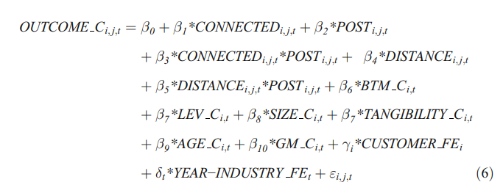
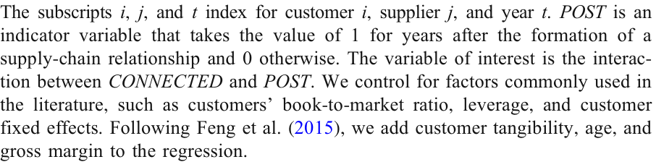
The effect of personal connections on customer operations
four alternative measures of operating efficiency: (1) volatility of inventory (INV_STD_C), (2) volatility of cost of goods sold (COGS_STD_C), (3) sales efficiency (SALE_ASSET_C), and (4) return on assets (ROA_C)

Slide 21
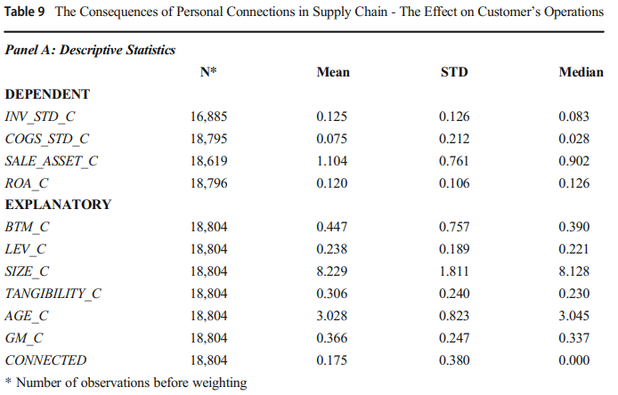
The effect of personal connections on customer operations
Panel A reports descriptive statistics for the variables used in the analysis. Each observation in the table represents a customer-year. The sample spans over 12 years.
17.5% of firm-year observations have connections, which is lower than 28.4% for customer-supplier pairs reported in Table 3. This lower percentage is due to the dilution caused by including customer firm-years before the formation of a connected supply-chain relationship, in which case CONNECTED takes the value of 0.

Slide 22
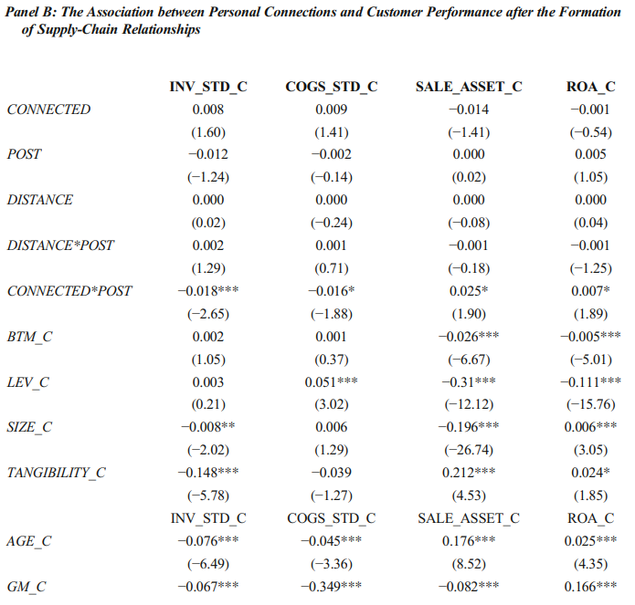
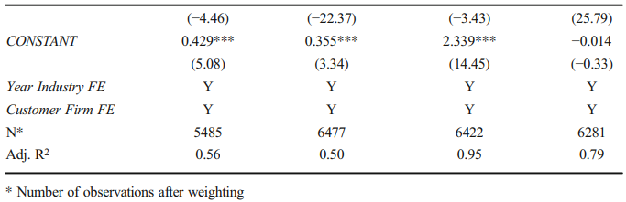
The effect of personal connections on customer operations
Panel B reports regression results. Weighted least squares (WLS) is used to account for large customers (e.g., Walmart), which have multiple suppliers in the sample.
Notes:
The coefficient on POST is not significant across the specifications, implying firm operating efficiency does not change after transacting with an unconnected supplier. The interaction between CONNECTED and POST is, however, negative and significant for volatility of both inventory and cost of goods sold and positive and significant for sales efficiency and ROA. These results supports the hypothesis that personal connections can mitigate information asymmetry in the supply chain and highlights the real value of personal connections in improving a firm’s operational efficiency.
These results further suggest the role of personal connections in supplier choice is less likely due to currying favor, a motive that was found to affect supplier selection in the context of political connections. The reason is that, under the currying-favor view, we would have observed lower operating efficiency, following the formation of a personally connected supply chain.

Slide 23
Conclusions
The likelihood that a potential supplier (hereafter, a vendor) is selected to be an actual supplier (hereafter, supplier) increases when personal connections between executives of the vendor and the customer exist.
The magnitude of the effect varies predictably across management ranks and positions and is stronger when information asymmetries between a vendor and a customer are high.
Conditioning on the existence of a supply-chain partnership, a departure of a personally connected executive prompts the termination of the supply-chain relationship more often than a departure of an unconnected executive.
Additional analyses show personal connections are associated with less restrictive procurement contracts and with improved customer performance after the formation of a supply-chain relationship.

Slide 24
Thank you!

